Slide 1
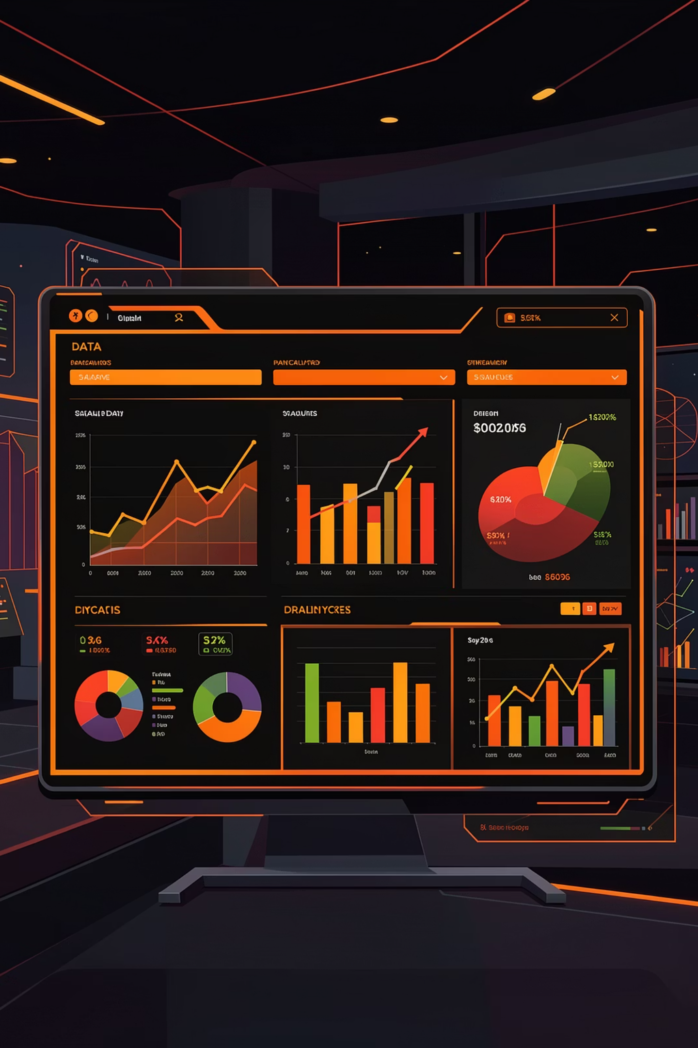
Customer Shopping Behavior Analysis
Uncovering insights from 3,900 purchases to guide strategic business decisions through data-driven analysis of spending patterns, customer segments, and product preferences.

Slide 2


DATASET OVERVIEW
Understanding Our Data Foundation
3,900 Transactions
Complete purchase records across all product categories
18 Key Features
Demographics, purchase details, and shopping behavior metrics
High Data Quality
Only 37 missing values in Review Rating column

Slide 3

DATA PREPARATION
Python Data Cleaning & Engineering
01
Data Loading & Exploration
Imported dataset with pandas, analyzed structure and summary statistics
02
Missing Data Handling
Imputed Review Rating nulls using median rating per product category
03
Feature Engineering
Created age_group bins and purchase_frequency_days columns
04
Database Integration
Connected to PostgreSQL and loaded cleaned data for SQL analysis

Slide 4
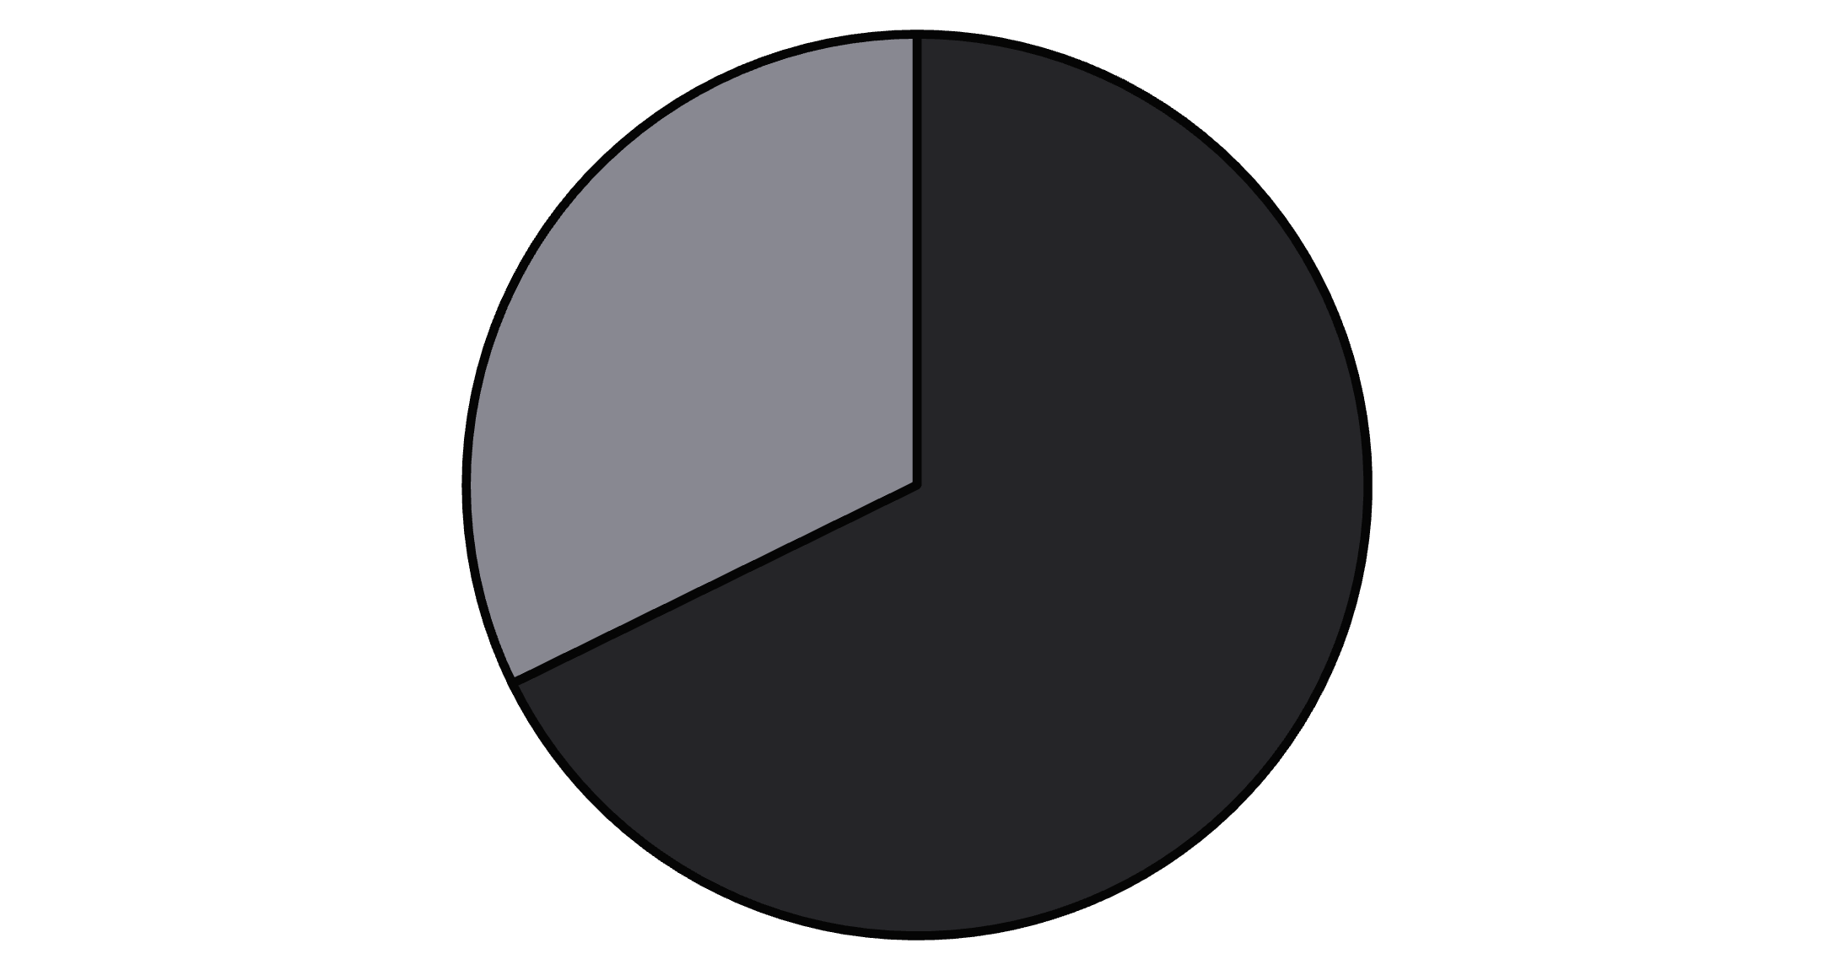
Revenue Insights by Gender
Male Customers Drive Revenue
Male customers generated $157,890 in total revenue compared to $75,191 from female customers—representing 68% of total sales.
This significant disparity suggests opportunities for targeted marketing campaigns to increase female customer engagement and spending.
Male
Female

Slide 5
KEY FINDING
Smart Discount Users
High-Value Discount Shoppers
839 customers used discounts while spending above the average purchase amount of $59.76.
These savvy shoppers demonstrate that discounts don't necessarily mean lower revenue—they attract quality customers who make substantial purchases.
839
$60+
Smart Shoppers
Purchase Value
Discount users spending above average
Above-average spending despite discounts

Slide 6
Top-Rated Products
77%
77%
76%
Gloves
Sandals
Boots
Highest rated at 3.86 stars
Strong performance at 3.84 stars
Customer favorite at 3.82 stars
76%
76%
Hat
Skirt
Well-received at 3.80 stars
Quality product at 3.78 stars
These top-rated products should be featured prominently in marketing campaigns and inventory planning to capitalize on customer satisfaction.

Slide 7
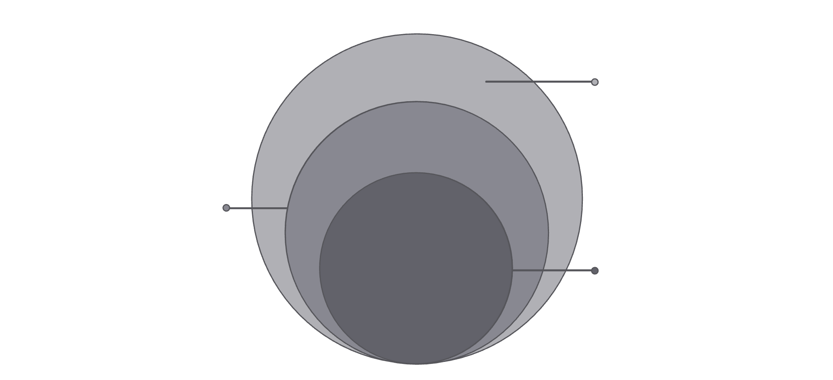
Customer Segmentation Analysis
Loyal Customers
3,116 customers (80%)
New Customers
Consistent repeat purchasers forming our core customer base
83 customers; recent acquisitions
Returning Customers
Returning Customers
701 customers; occasional repeat buyers
701 customers (18%)
Loyal Customers
Growing engagement with potential to become loyal
3,116 customers; core repeat purchasers
New Customers
Customer loyalty is strong, with 80% classified as Loyal based on purchase history.
83 customers (2%)
Fresh acquisition opportunities for growth

Slide 8
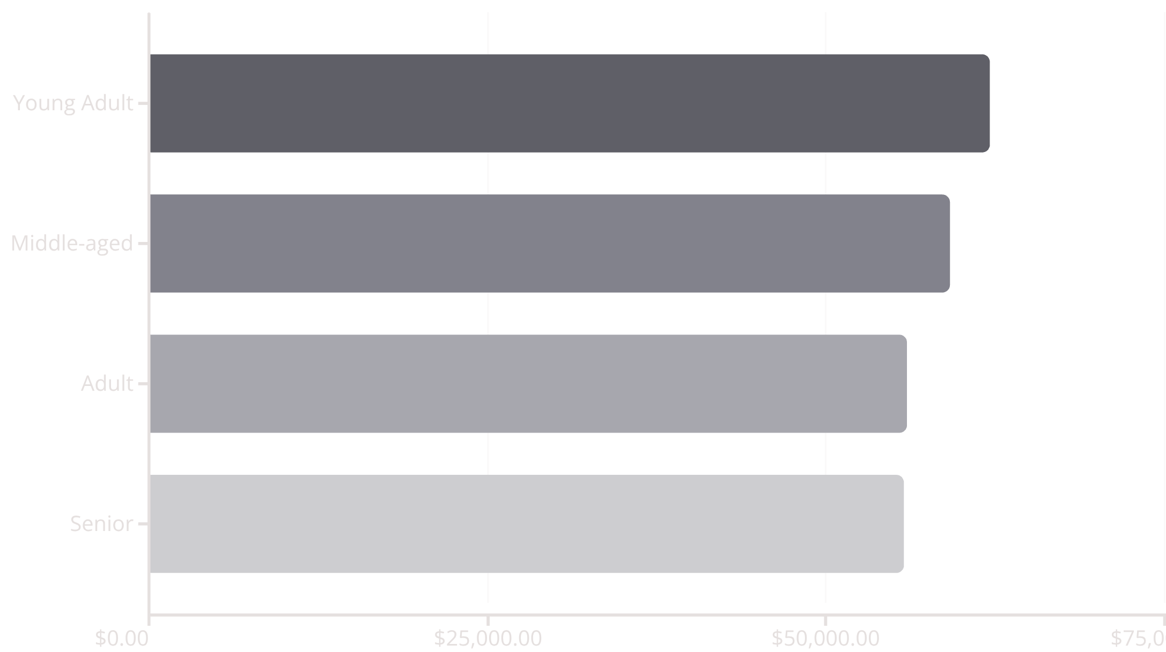
REVENUE ANALYSIS
Revenue Distribution by Age Group
Balanced Age Distribution
Young Adults lead revenue at $62,143, but all age groups contribute relatively evenly—ranging from $55,763 to $62,143.
This balanced distribution indicates broad market appeal and suggests multi-generational marketing strategies will be effective.

Slide 9
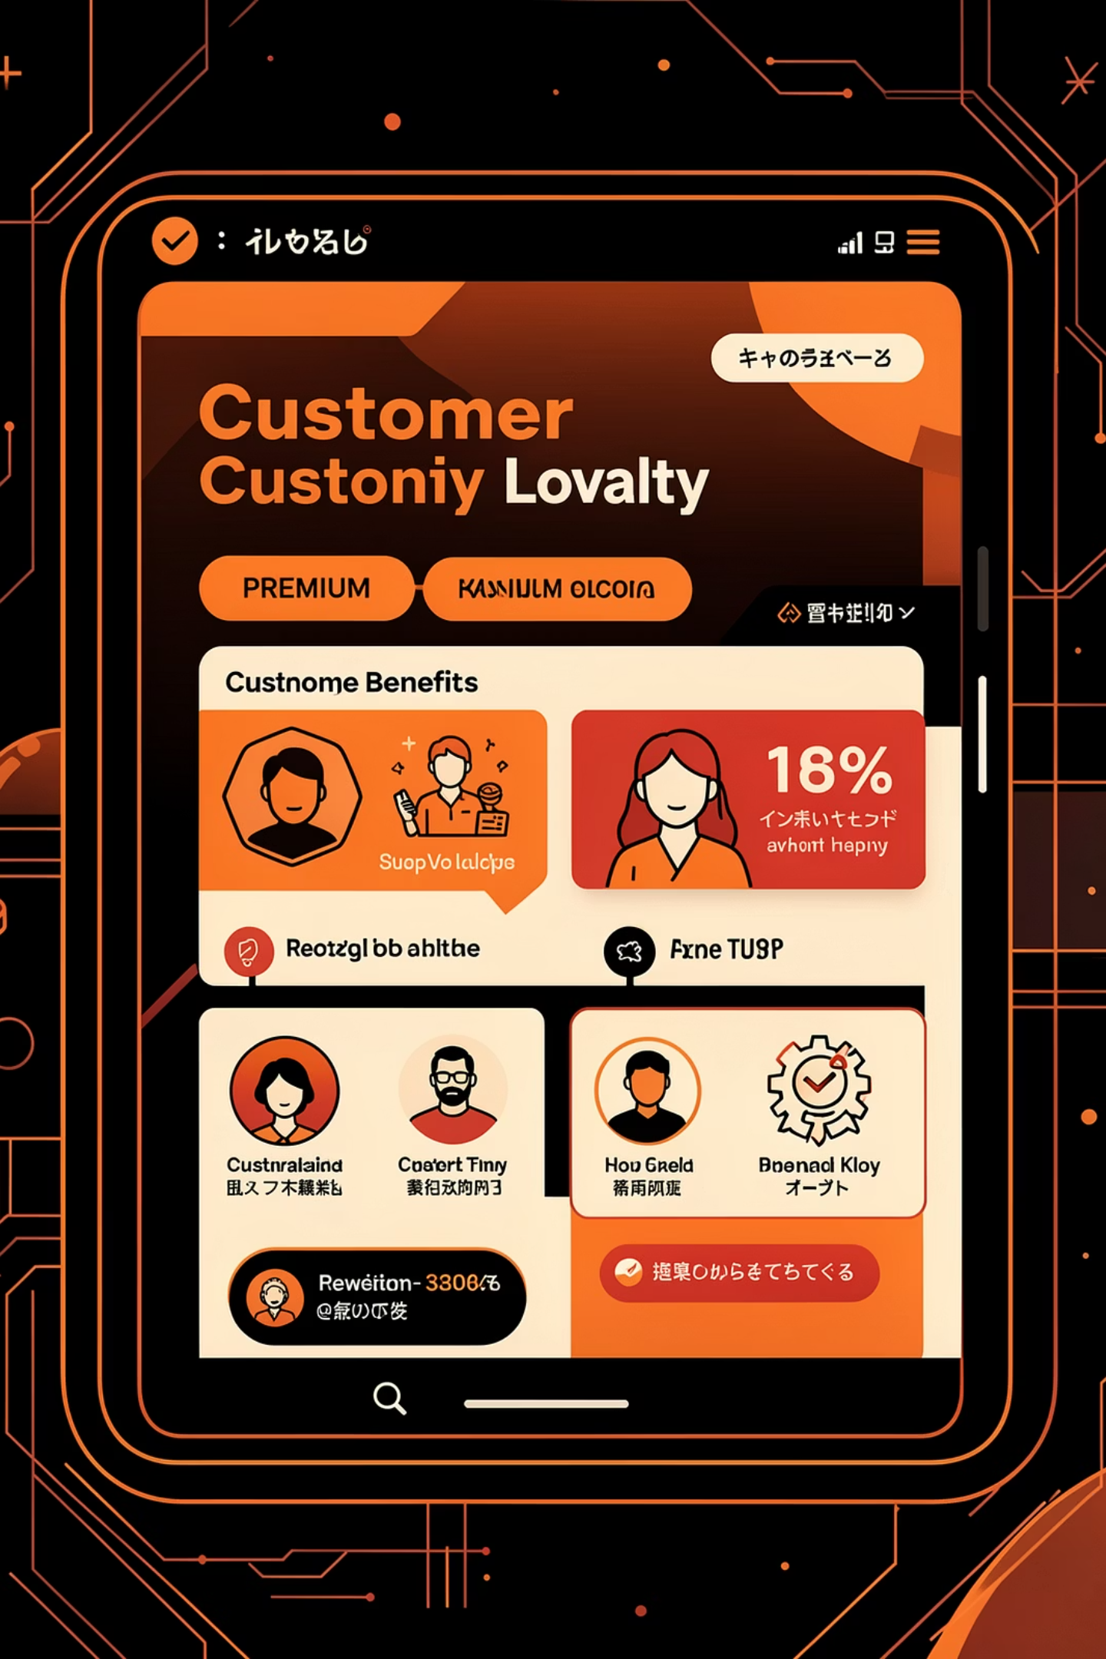
Subscription Impact Analysis
Subscription Opportunity
1,053 subscribers generating $62,645 in revenue
2,847 non-subscribers contributing $170,436
958 repeat buyers (>5 purchases) are subscribers
Massive growth potential in converting non-subscribers
Only 27% of customers are subscribers, yet they maintain similar spending patterns to non-subscribers.
Average spend: $59.49 vs $59.87

Slide 10





ACTION PLAN
Strategic Business Recommendations
Boost Subscriptions
Loyalty Programs
Review Discounts
Product Positioning
Promote exclusive benefits to convert the 73% non-subscriber base
Reward repeat buyers to accelerate movement into Loyal segment
Balance sales boosts with margin control for sustainable growth
Highlight top-rated items like Gloves and Sandals in campaigns
Targeted Marketing
Focus on Young Adults and express-shipping users for maximum ROI

